Slide 1
Mastering Conditional Rendering in React
Building Dynamic, Performant User Interfaces

Slide 2
Agenda
Why Conditional Rendering Matters in Modern Apps
Declarative Philosophy vs Imperative DOM
The 6 Core Conditional Rendering Techniques
Component Trees, Identity & Reconciliation
React Fiber: Render & Commit Phases
Mounting, Unmounting & State Lifecycle

Slide 3
Why Conditional Rendering?
Modern UIs are highly dynamic and state-driven.
Common scenarios:
User login → Dashboard switch
Data loading → Spinner
API errors → Error messages

Slide 4
Traditional Imperative Approach
// Selecting the element directly
const login = document.getElementById('login-form');
// Explicitly changing the style attribute
// This causes a synchronous layout reflow and repaint
login.style.display = 'none';

Slide 5
React’s Declarative Philosophy
Describe WHAT the UI should be.
React handles the HOW.

Slide 6
The Core Equation
UI = f(State)

Slide 7
6 Conditional Rendering Techniques
Technique | Best Use | Example
Early Return | Large branches | if (loading) return <Spinner />;
Ternary | Two choices | cond ? <A/> : <B/>
&& | Optional | isAdmin && <Admin/>
Element Var | Complex logic | let btn = isAdmin && <Btn/>;
null | Hide | if (!show) return null;
Object Map | Multiple | views[role]

Slide 8
Technique 1: Early Returns
function Dashboard() {
if (loading) return <Spinner />;
if (error) return <Error />;
if (!loggedIn) return <Login />;
return <MainContent />;
}

Slide 9
The React “0” Bug
The Issue: Falsy 0
JSX treats 0 as a valid node to render, not a falsy value.
Using {items.length && } often results in the string "0" being displayed in your UI.
This occurs because && returns the first falsy value it finds, which is 0 in this case.

Slide 10
Fix 1: Explicit Comparisons
// The Wrong Way
{items.length && <List />}
// If length is 0, React renders "0" to the screen.
// The Correct Way
{items.length > 0 && <List />}
// Comparison forces a boolean result. React ignores false values.

Slide 11
Fix 2: Ternary Operators
// Use ternary operators for cleaner control flow when you have an "else" case.
{items.length > 0 ? <List /> : null} //ensures you explicitly control what renders when empty.
// This is often preferred in UI logic as it makes empty-state handling obvious to other developers.

Slide 12
State Preservation Rule
Approach | State Preserved? | Mount/Unmount | Use Case
{show && <Comp/>} | No | Yes | Structural changes
<Comp hidden={!show}> | Yes | No | Frequent toggles

Slide 13
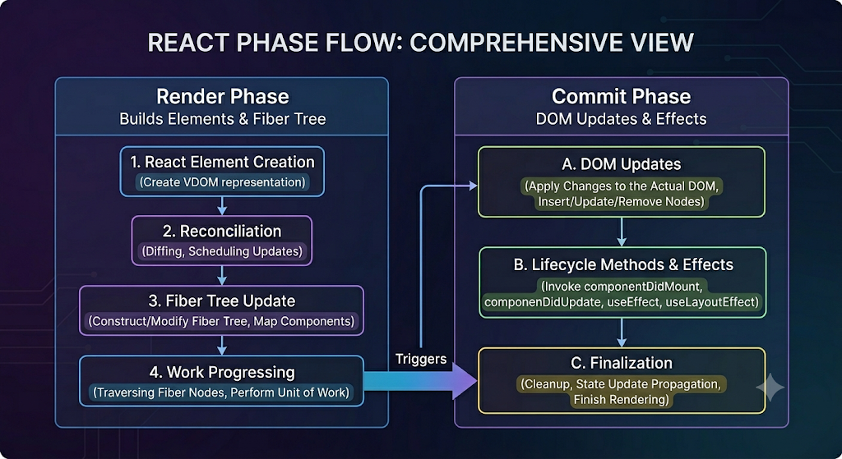

Slide 14
Modern React Patterns
Pattern | Use Case
Suspense | Async data with fallbacks
useTransition | Non-urgent updates
useOptimistic (19) | Optimistic UI
use() | Async resources

Slide 15
React Suspense
What Suspense Does
Handles async UI rendering declaratively
Lets React pause rendering until data is ready
Shows a fallback UI while waiting
<Suspense fallback={<LoadingSpinner />}>
<UserPage />
</Suspense>
Mental Model
❌ “I manage loading states in components”
✅ “React decides when to render or show fallback”

Slide 16
React useTransition
“Not all updates need to happen immediately.”
What is useTransition?
A React Hook for marking updates as non-urgent
Lets React keep the UI responsive during heavy work
Enables interruptible rendering
Mental Model Shift
❌ Everything is urgent (blocking UI)
✅ Separate urgent vs non-urgent updates
Key Benefit
Keeps typing, clicking, and interactions smooth
Moves heavy rendering to background priority

Slide 17
import { useTransition, useState } from "react";
function SearchPage() {
const [query, setQuery] = useState("");
const [results, setResults] = useState([]);
const [isPending, startTransition] = useTransition();
function handleChange(e) {
const value = e.target.value;
// Urgent update
setQuery(value);
// Non-urgent update
startTransition(() => {
setResults(expensiveSearch(value));
});
}
return (
<div>
<input value={query} onChange={handleChange} />
{isPending && <p>Updating results...</p>}
<SearchResults results={results} />
</div>
);
}

Slide 18
useOptimistic
“Show the result immediately, assume success, correct later if needed.”
What is useOptimistic?
A React Hook for optimistic UI updates
Updates the UI before the server confirms the change
Later reconciles with real server state
Mental Model Shift
❌ Wait for server response before updating UI
✅ Update UI instantly, then sync with reality
Where It’s Used
Likes / reactions, Form submissions
Messaging apps, Todo updates

Slide 19
import { useOptimistic, useState, useTransition } from "react";
function TodoApp() {
const [todos, setTodos] = useState([
{ id: 1, text: "Learn React" }
]);
const [optimisticTodos, addOptimisticTodo] = useOptimistic(
todos,
(state, newTodo) => [...state, newTodo]
);
const [isPending, startTransition] = useTransition();
function handleAddTodo(text) {
const newTodo = { id: Date.now(), text };
// 1. Update UI immediately
addOptimisticTodo(newTodo);
// 2. Sync with server
startTransition(async () => {
await saveTodoToServer(newTodo);
setTodos((prev) => [...prev, newTodo]);
});
}
return (
<div>
<TodoList todos={optimisticTodos} />
{isPending && <p>Saving...</p>}
</div>
);
}

Slide 20
React use() (Async Data Consumption in Render)
“Read async data as if it were synchronous UI state.”
What is use()?
A React function for reading async resources directly in render
Works with Promises, Context, or data sources
Can suspend rendering automatically
Mental Model Shift
❌ Fetch data in useEffect → store in state → render
✅ Read data directly in render → React handles waiting
Where It Fits
Server Components (React 18+ / 19+ patterns)
Suspense-enabled data fetching
Framework-level data loading (e.g. Next.js)

Slide 21
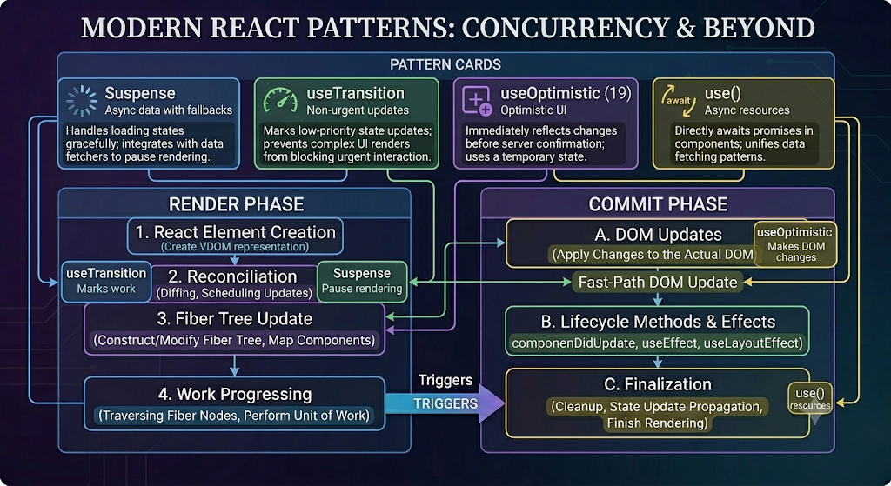

Slide 22
Exercise

Slide 23
Interactive Exercise
Refactor the UserPage component using early returns and consider Error Boundaries.
function UserPage({user, loading, error}) {
// Your refactored version here
}

Slide 24
Solution Walkthrough

Slide 25
The Problem with Traditional Patterns
Components often mix:
Data fetching
Loading state
Error handling
Results in:
Conditional rendering clutter (if/else, ternaries)
Tight coupling between UI and data logic
Harder reuse and testing
if (loading) return <Spinner />;
if (error) return <ErrorMessage />;
return <UserProfile user={user} />;

Slide 26
Why This Becomes a Scalability Issue
Every component reimplements the same patterns
Inconsistent loading/error UX across the app
Business logic leaks into presentation layer
Difficult to standardize async behavior

Slide 27
Introducing the Refactored Structure
Separation of Concerns
UserProfile → pure UI component
UserPage → orchestration layer
function UserProfile({ user }) {
return (
<div>
<h1>{user.name}</h1>
<p>{user.bio}</p>
</div>
);
}

Slide 28
Container with Imperative Guards
Centralizes state handling
Still relies on explicit conditionals
function UserPage({ user, loading, error }) {
if (error) return <ErrorMessage message={error.message} />;
if (loading) return <Spinner />;
return <UserProfile user={user} />;
}

Slide 29
Limitation of this approach
Still “manual state orchestration”
UI logic tied to data lifecycle
Not composable at scale
Doesn’t align with modern React concurrency model

Slide 30
Enter Suspense & Error Boundaries
Key Idea:
Move async state handling out of the component
Suspense → handles loading state
Error Boundary → handles failure state
These become declarative wrappers, not inline logic

Slide 31
Declarative Version
function UserPage() {
const user = useUser(); // Suspense-enabled data source
return <UserProfile user={user} />;
}
// No loading. No error. No conditionals.

Slide 32
Composition at the App Boundary
Cross-cutting concerns move upward
UI becomes predictable and composable
<ErrorBoundary fallback={<ErrorDisplay />}>
<Suspense fallback={<LoadingSpinner />}>
<UserPage />
</Suspense>
</ErrorBoundary>

Slide 33
Mental Model Shift
Before:
“How do I handle loading and error states here?”
After:
“What does this component render when data is ready?”

Slide 34
Why This is Better
Separation of concerns
  UI ≠ data lifecycle
Declarative architecture
  Describe states, don’t manage transitions
Reusable boundaries
  One loading/error system for many components
Scalable patterns for large apps

Slide 35
Key React Concepts Involved
React
Suspense
Error Boundary
use() hook (future-ready data consumption model)

Slide 36
Architecture Takeaway
Move from inline control flow
Toward composable UI boundaries
Shift responsibility:
  Components → render logic
  Boundaries → state orchestration

Slide 37
Solution Code
// 1. Presentation Component (Pure UI)
function UserProfile({ user }) {
return (
<div>
<h1>{user.name}</h1>
<p>{user.bio}</p>
</div>
);
}
// 2. Page Component (No State Logic)
function UserPage() {
const user = useUser(); // Suspense-enabled data source
return <UserProfile user={user} />;
}
// 3. Application Composition (Boundaries Handle State)
<ErrorBoundary fallback={<ErrorDisplay />}>
<Suspense fallback={<LoadingSpinner />}>
<UserPage />
</Suspense>
</ErrorBoundary>

Slide 38
End of Solution Walkthrough

Slide 39
Questions?

